Slide 1

Analyzing Mental Health using Instagram Posts
MINOR PROJECT - 1
Team members:
Anshika Bajpai (9917103009)
Vishal Kumar (9917103204)
Rohan Kumar (9917103227)
Under supervision of:
Mrs. Anuradha Gupta

Slide 2
PROBLEM STATEMENT
Social media platforms present a promising new opportunity for early detection of user’s mental health. Analyzing mental health based on these platforms can benefit many applications in public health and social welfare.
Most research done in detecting mental health only focused on single labelled classification and ignored the co-existence of multiple mental state labels in one instance.

Slide 3
STATE-OF-THE-ART
1. Mental Health Screening tools/sites
Best. to analyze mental health, can find the exact cause and can help in recovery. For example: Society Anxiety Test, OCD Test, Depression Test.
Limitations –
Based on survey
Questionnaires
Presence of mind and consciousness required during questionnaire
Ignores unconscious behavior (on low level tests)
Do not analyze social media post on day to day basis
2. Android/IOS Applications
Apps are designed to “ overcome stress and negative thoughts ” and can be downloaded on mobile phones. Provides various games and real life tips to implement on daily lifestyle to improve it. For example: Headspace, Talklife

Slide 4
Limitations –
Does not keep track record of social media life
Ultimately leads to questionnaire
Cannot analyze the views expressed on social media
Do not consider unconscious behavior
 | MHS | Apps | Our model
Survey based | Yes | No | No
Questionnaire | Yes | Maybe | No
Based on online activity | No | No | Yes
Based on past records | Yes | No | Can be modified to it
Unconscious posts | Maybe | No | Yes

Slide 5
OBJECTIVES
This project will consist of various datasets that are been recorded to analyze the persons behavior and mental state. This can result as a machine learning and deep learning model being an evaluator of mental health which will help in getting to know user’s mind better.

Slide 6
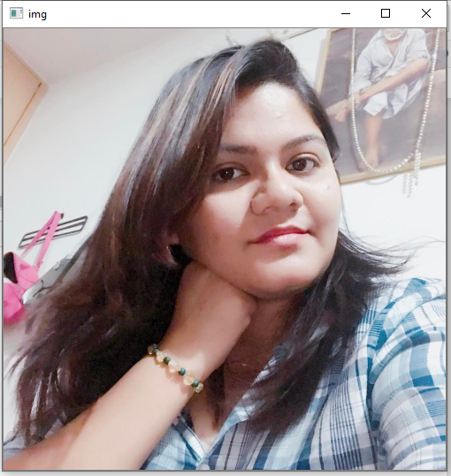
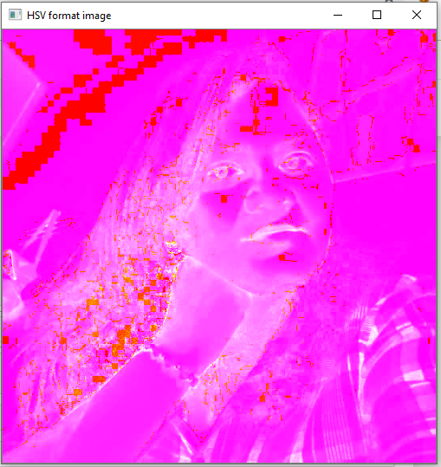
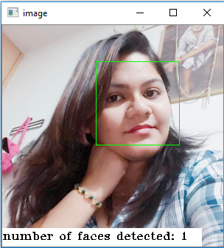
PROPOSED DESIGN AND IMPLEMENTATION
1) Dataset:
Data was extracted on the basis of keywords(also known as query terms).
15 keywords per label (labels: Anger, Depressed, Fear, Happy)
Data was filtered .
Posts discarded that contains irrelevant keywords
Posts discarded that were not in English language
2) Image analysis:
HSV details evaluated
Face count in photographs evaluated
Random forest classifier used

Slide 7
3) Text pre-processing:
First the caption part of the post were split into training and testing sets where testing included 200 posts of each and training included remaining.
Then the caption part of the posts were tokenized and the irrelevant word like typos, words starting with ‘#’ and ‘@’, grammatically incorrect word were filtered out.
After the above process the texts remaining for processing for each label were:
Training Testing
Angry 2086 194
Happy 2684 195
Depression 2122 199
Fear 3014 194

Slide 8
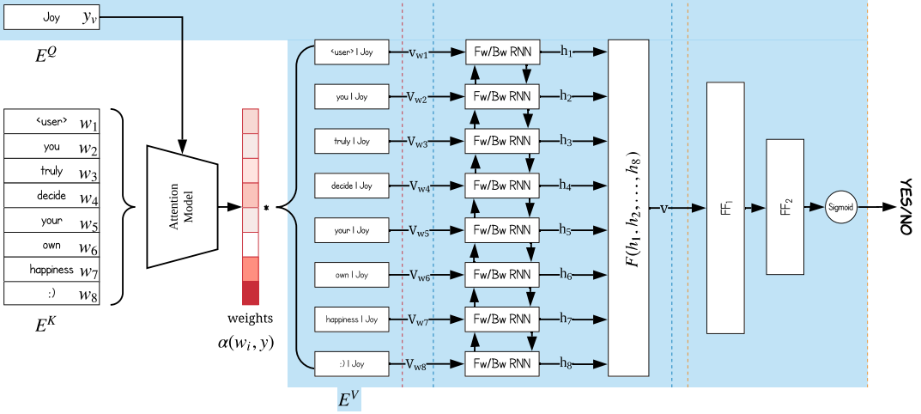
4) Text analysis:
5) Flags:
2 flags for extra features are considered
i) Indoor-Outdoor
ii) Emoticons
6) Feature extraction:
i) POS tagging
ii) TF-IDF
iii) sentiment analyzer

Slide 9
RESULT AND ANALYSIS
DATASET
9630 posts extracted using APIFY
Post information like likes count, followers count, following count, post counts, etc. was extracted via URL
HSV details were recorded successfully using OpenCV2
Number of human faces detected using OpenCV2
Sentiment Score, TF-IDF weights, POS tagging values recorded using sklearn
Flag is set to ‘1’ and ‘2’ if image clicked in indoor and outdoor respectively.
By these data the flags as assumed to be set to ‘0’ as their value does not fit the model condition.

Slide 10
FEATURES
All the image features extracted were analysed and trained using Random Forest Classifier and the accuracy was compared.
To enhance the accuracy Correlation graph mapping using heatmap, RFE, Grid Search, Confusion Matrix, ROC-AUC curve and Cross Validation approaches evaluated.
The text is tokenized, entered in text analysis RNN model.
RESULTS
After successful training and testing of dataset using all the approaches mentioned above, Random Forest Classifier were having the accuracy of 44%

Slide 11
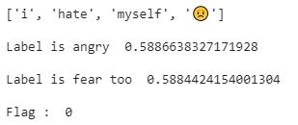
With RNN model the accuracy of label classification were:
Training Testing
Angry 61.36% 56.30%
Happy 20.38% 22.56%
Depression 66.49% 72.86%
Fear 78.33% 81.95%
Some judging :

Slide 12
CONCLUSION
Our model uses a new approach to detect the mental state of the person by using multi-label mental health classification task. Unlike any other model which uses either texts or images based on surveys and questionnaire or uses binary classification, our model uses the whole online post including the generally ignored likes count, emoticons and timestamp.
Our model involves both deep learning and machine learning models for better efficiency. The key components of the models were embedding module, image features and the flags. The multi-label classification shows the post relativity towards a particular label allowing us to conclude the overall post’s mental state.

Slide 13
FUTURE SCOPE
We created dataset that can be used in future for further implementation as per requirements.
We provided an opportunity to study a new platform that has certain limitations.
Further implementation on this model can be done using soft computing method which gives fuzzy values as a result.
Our model can be improved to judge multiple posts at a time instead of a single post, as of now.

Slide 14
THANK YOU !

